Slide 2
Call to Worship
“But let justice roll on like a river,
righteousness like a never-failing stream!”
(Amos 5:24, NIV)

Slide 3
Hymn Freedom is coming (StF 697)
Notes:
© 1990 WGRG, Iona Community, Glasgow, G2 3DH. wgrg.co.uk (CCLI)

Slide 4
Gathering Prayer Lord, as we gather as your people, a small community in the family of your worldwide Church, open us up to love of you and love of neighbour. We offer our hearts to your worship and our lives to your service. Renew our strength and re-kindle our vision as we meet to find our way, anew, in you. Amen.

Slide 5
Hymn Jesus calls us here to meet him (StF 28)
Notes:
© 1989 WGRG, Iona Community, Glasgow, G2 3DH. wgrg.co.uk (CCLI)

Slide 6
Prayers of Praise and Confession With the glory of Easter in our hearts, we come before you, loving God, in praise and thanksgiving. We worship and thank you for the good news that Jesus is risen and alive among us. For the knowledge that you are always with us, we praise you.

Slide 7
Your love encircles our world: we see you in the power and light of the sun, the strength of the wind and waves of the sea, the vastness and beauty of our universe and the balance of life from the microscopic insect to the largest sea creature. For the knowledge that you are always with us, we praise you.

Slide 8
We praise you for this world’s diversity and the variety of life, for the opportunities to serve you and one another each day. For the knowledge that you are always with us, we praise you.

Slide 9
And yet, we have taken your gifts for granted. We have ignored the signs of climate change, we have polluted rivers and seas, spoiling your wonderful creation. Teach us to live not by our values, but by yours.

Slide 10
We have not shared our resources, causing famines, hardship and wars. We have ignored cries for help. Teach us to live not by our values, but by yours.

Slide 11
Forgive us, Resurrecting God. Help us to revive your world, to find better ways to live in peace and harmony. Speak to us through this joyful season and fill us with greater trust and deeper faith so that we may live as people of your resurrection power. We ask this in the name of Jesus, our Risen Christ. Amen.

Slide 12
Watch Introduction to the World Mission Fund For this new video about the World Mission Fund go to: methodist.org.uk/WorldMissionFund

Slide 13
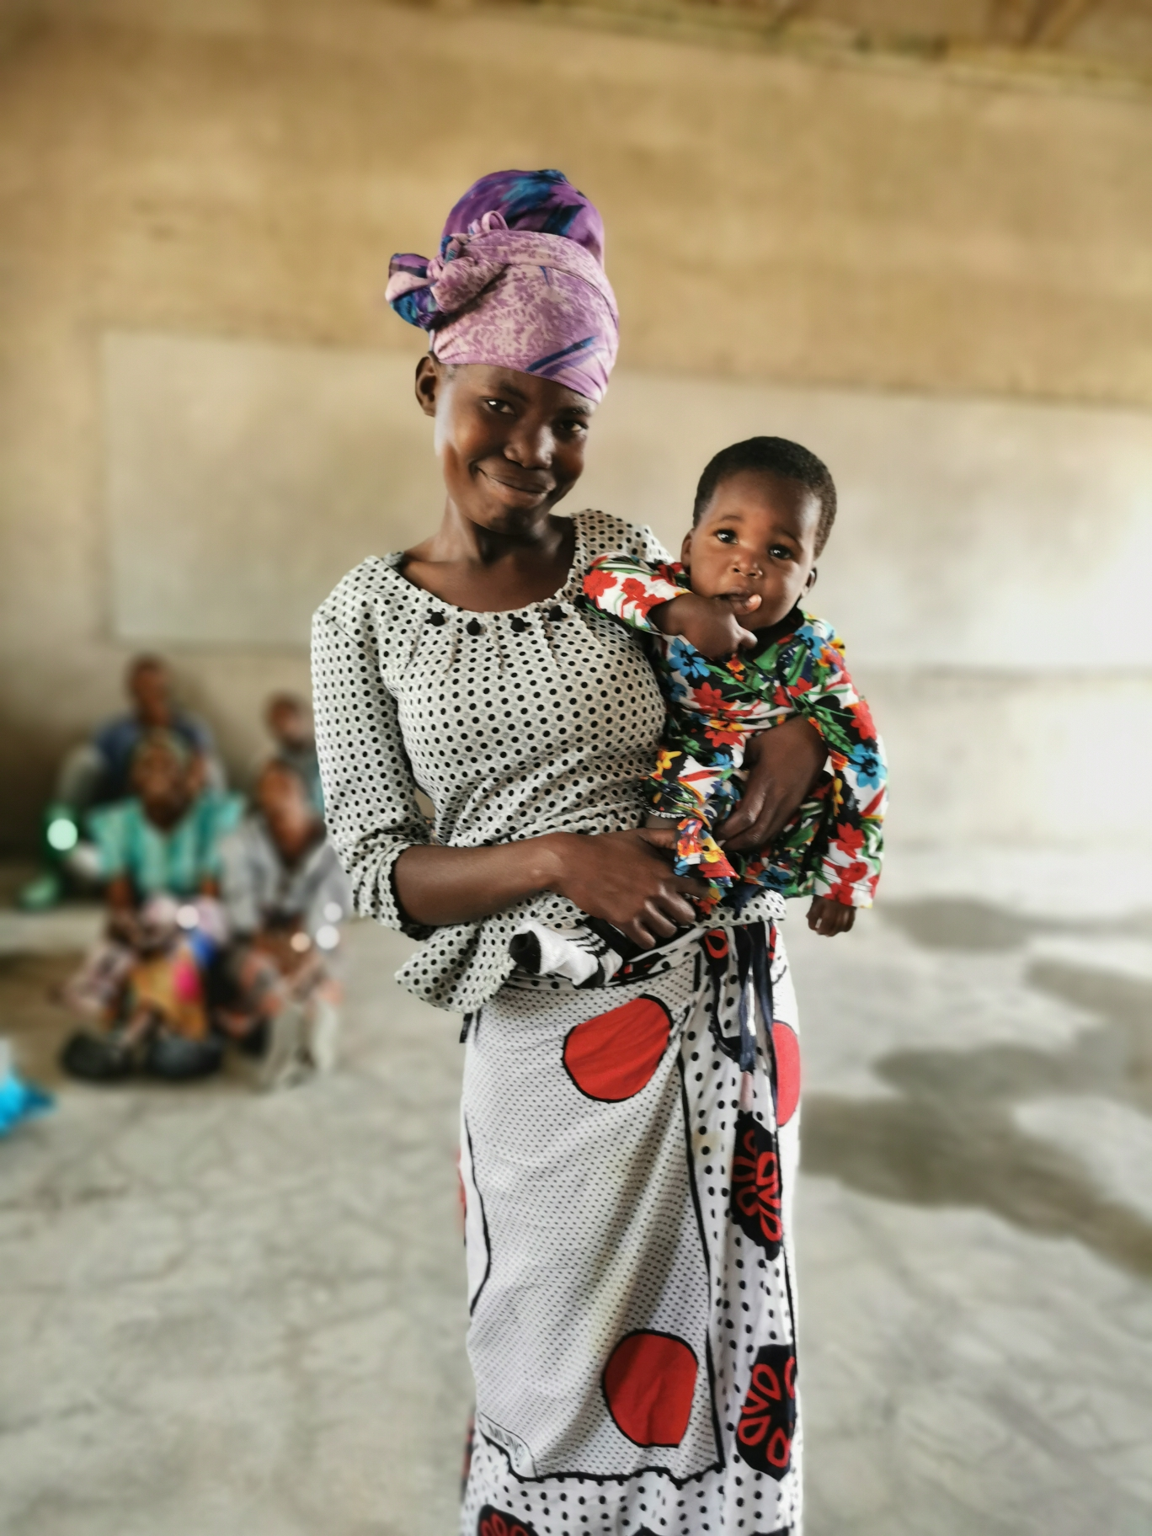
Story
Justice for people marginalised by disability:
a story from our global Methodist community
Notes:
Elizabeth from Tanzania © The Trustees for Methodist Church Purposes

Slide 14
Hymn Show me how to stand for justice (StF 713)
Notes:
© 1999, Kevin Mayhew Ltd, Buxhall, Stowmarket, Suffolk, IP14 3BW. (CCLI)

Slide 15
Reading
Luke 18:1-8

Slide 16
Reflection on the Reading

Slide 17
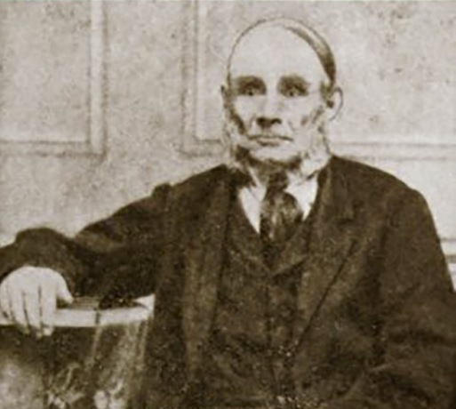
Story
Working for justice in an
unjust world: a story
from Methodist history
Notes:
George Loveless (1797 – 1874), Tolpuddle Martyr

Slide 18
Hymn Give to me Lord, a thankful heart (StF 520)
Notes:
Public domain.

Slide 19
Reflection
The seed of justice

Slide 20
Reading
Amos 5:18-24

Slide 21
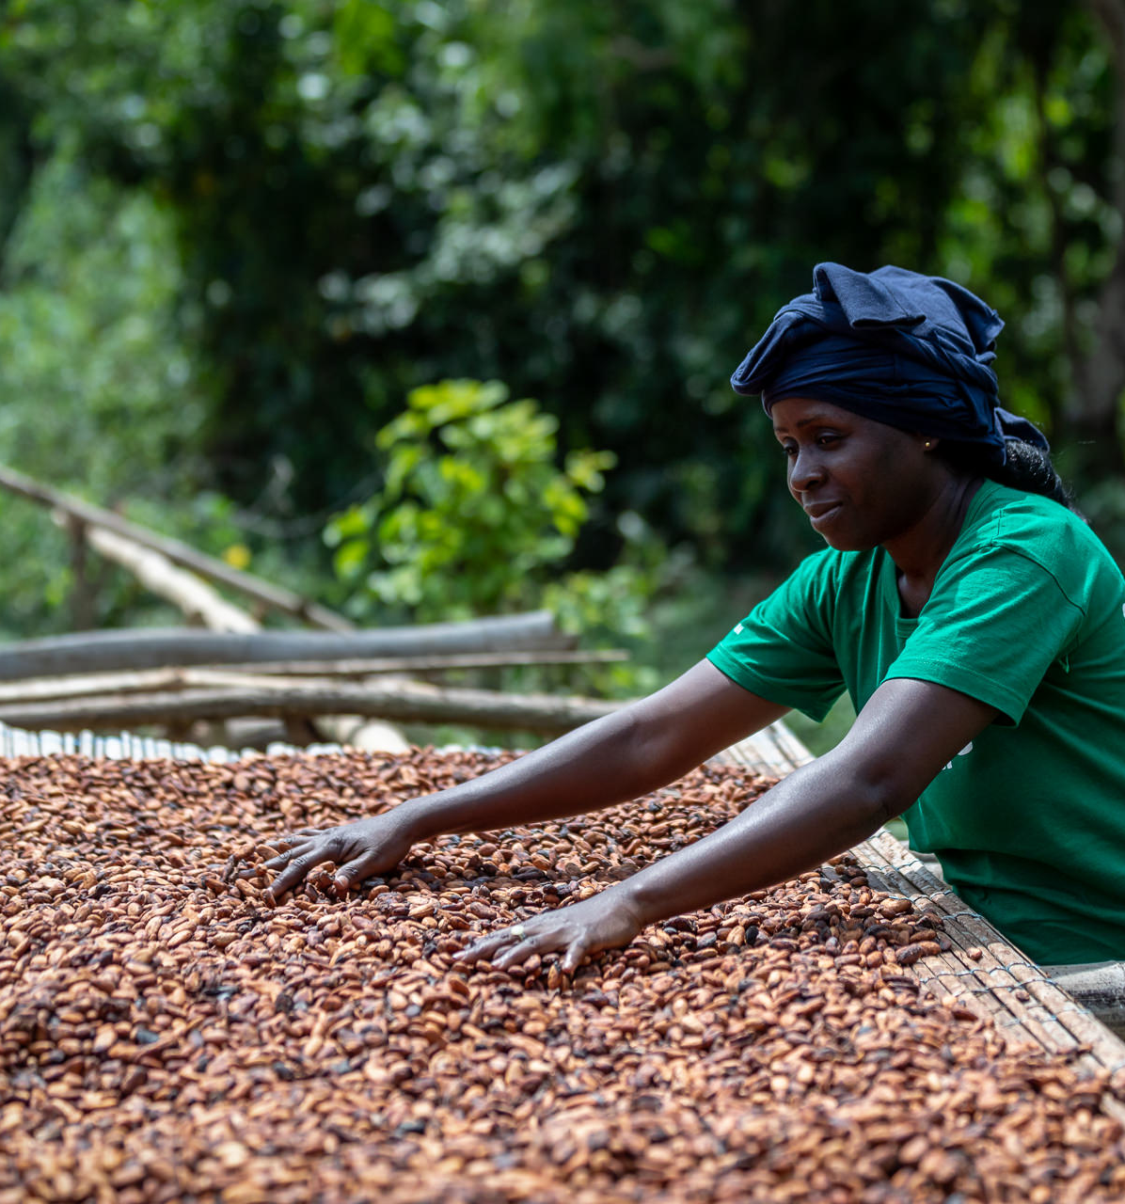
Story
Working for justice in a moving picture: the fair trade story
Notes:
Edith with Cocoa Beans © FairTrade/Chris Terry

Slide 22
Hymn Pray for a world where every child (StF 527)
Notes:
© 1996 The Pilgrim Press, 700 Prospect Avenue East, Cleveland OH 44115-1000 USA (One Licence)

Slide 23
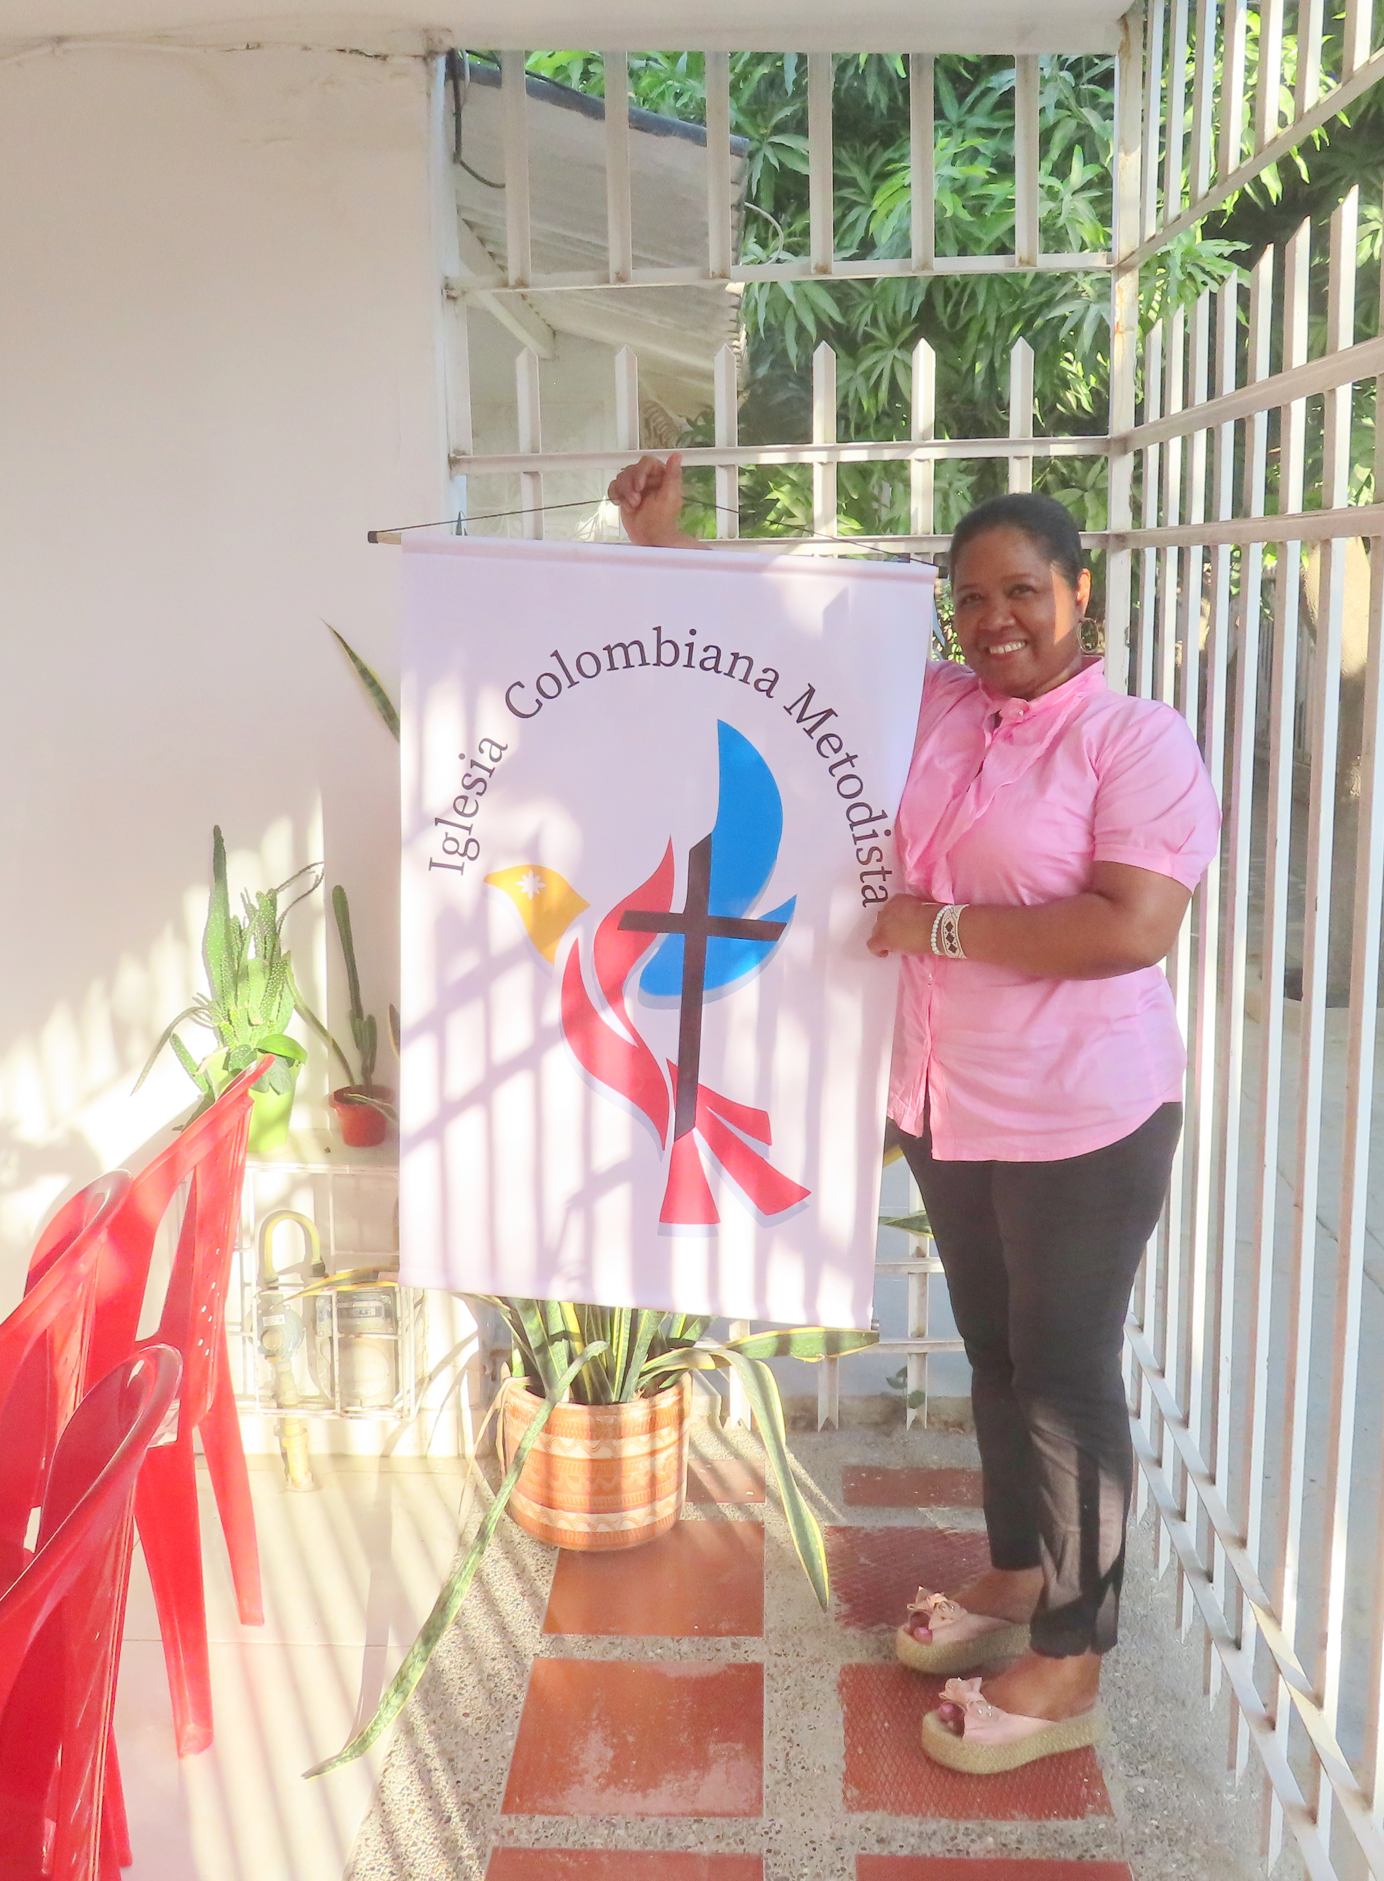
Story
The battle for justice continues: a story from Columbia
For a video showing more on the battle for justice in Columbia go to: mwib.org.uk
Notes:
© Methodist Women in Britain

Slide 24
Prayers of intercession Loving God, We hold before you the people in the stories we have just heard. With hope, we reimagine this world as a better world where justice and love reign. We pray for a fairer world, a world where peace and justice abound. Let justice roll, and may your kingdom come.

Slide 25
We pray for people who seek your will here on earth: those who strive for peace, campaign for justice, fight for the oppressed, the exploited, the under-privileged; those who seek to eliminate hunger and poverty. Let justice roll, and may your kingdom come.

Slide 26
We pray for people who have experienced a miscarriage of justice: people who have been discriminated against unjustly, people who have been falsely accused, people who have been wrongfully imprisoned or unfairly punished Let justice roll, and may your kingdom come.

Slide 27
As we experience the results of climate change, we pray for people on whom it is having a devastating impact and for people who have been displaced. We give thanks for those people who have welcomed and offered hospitality, for those campaigning for climate justice. Let justice roll, and may your kingdom come.

Slide 28
As a justice-seeking Church, give us wisdom, integrity and dedication so that we may recognise where there are injustices. Help us to act upon them, always seeking your guidance. Let justice roll, and may your kingdom come.

Slide 29
Say together the Lord’s Prayer, in the language of your heart.

Slide 30
Hymn God has spoken (StF 157)
Notes:
© 1953, renewed 1981 The Hymn Society in the United States and Canada. Administered by Hope Publishing Company, Carol Stream, IL 60188 USA. (One Licence)

Slide 31
Dedication of Offering Let us stand and say together: Loving and gracious God, we bring the offerings for the work of the Methodist Church through its World Mission Fund. May the money be used to support where there is need, and to share your love which we know from the life of Jesus Christ, our Saviour. We pray for those who will share in the distribution of the funds, and for those who will be recipients, that each may learn more of your generous hospitality and love for all humankind. Amen.

Slide 32
Benediction Loving God, Renew our passion for justice. Open our minds as we serve you in our daily lives. May we see the world through your eyes, may we listen with your ears. Send us out with your love and purpose in our hearts to do your will, to live and work for your kingdom and for your glory now and always. Amen.

Slide 33
To support the World Mission Fund, go to: methodist.org.uk/WorldMissionFund
Notes:
INSERT CCLI OR ONE LICENCE NUMBERS HERE IF NECESSARY

