Slide 1
Endings
‘For everything there is a season, and a time for everything under heaven’
Notes:
Focus of todays session – Endings, in a church context.
Take care/ TW – talking about ‘endings’ is sometimes difficult. Although we are focusing on church and faith, this can be difficult, or painful and may touch on experiences in other areas of your life. This current ‘liminal’ season – we are anticipating ‘endings. Mission Action Planning – we talk of starting new things but what about the ceasing, pruning or pausing also needed?

Slide 2
Endings
Thinking about church/ faith context: why and how do things end?
Endings as completion
Endings as loss
Both can be challenging in different ways.
What examples might you share from your own experience?
‘Whatever the reasons for closure, the human cost is likely to be great’ (John Leach)
Notes:
Endings as completion – a work finished (eg., building project, a ‘one off’ event) and chance to celebrate
Endings as loss /decline – loss of ‘resources’ (funding, people/ volunteers). Can be sudden or gradual
Are there examples you can offer from your own experience?

Slide 3
Why do things come to an end?
They aren’t working out – perhaps a new initiative that’s been tried but hasn’t developed as hoped
It’s outlived it’s usefulness/purpose: often characterised by a slow dwindling in numbers, systems /structures which no longer work, feeling like ‘yesterday’s project/ organisation’
It’s ‘in the way’ of something better, or the ‘new shoots’ of growth eg., a long standing booking in church hall which prevents other missional events taking place
It is on a roll –perhaps grown beyond what the church /organisation can manage
Notes:
‘Sometimes things have to stop not when they are in decline but when they seem to be booming (John Leach)’ eg. Mark 1, Jesus Ministry in Galilee. Mission is not about our personal ‘success’ or ‘popularity’.

Slide 4
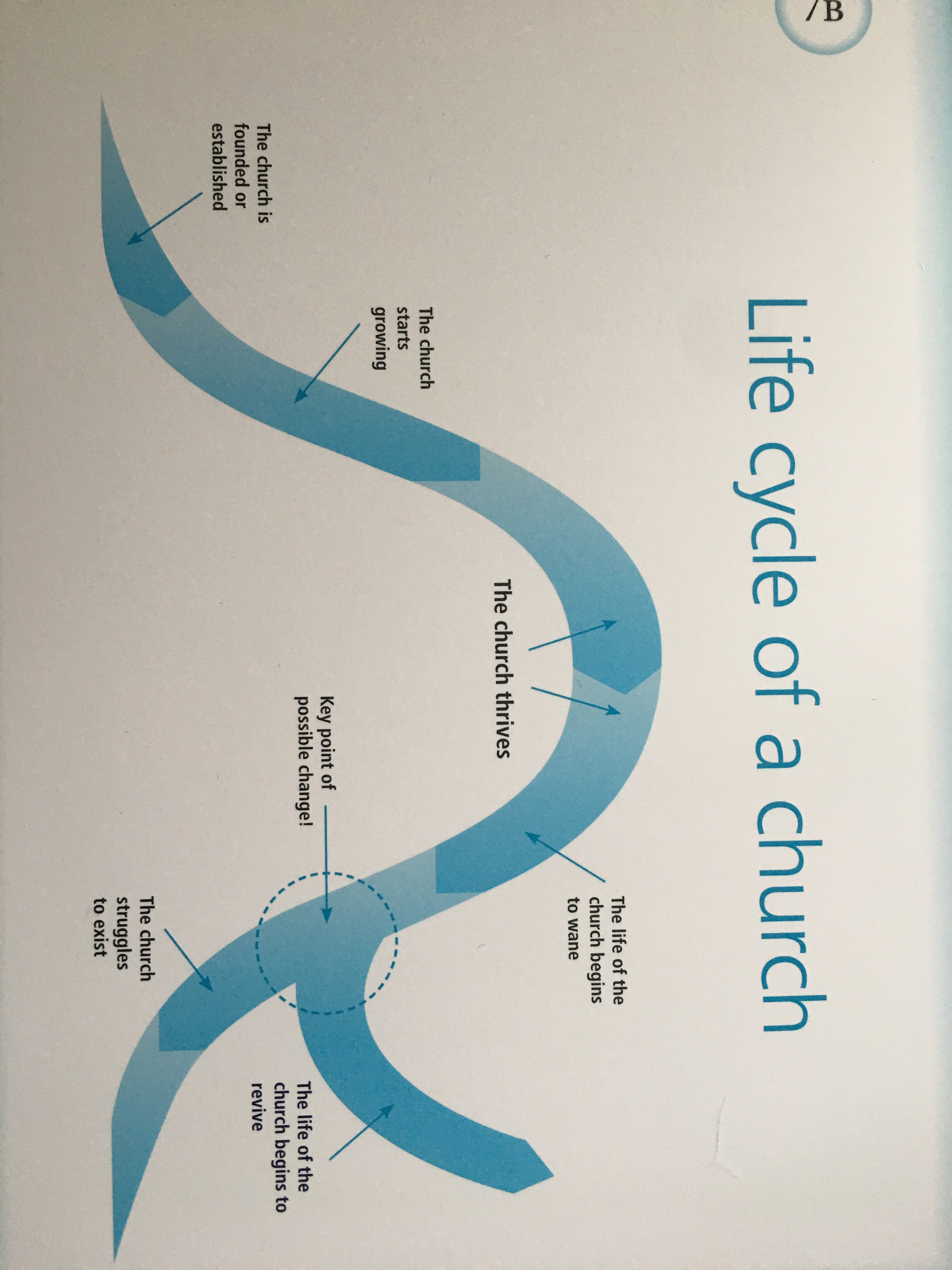
‘Our Church’s Future Story’ – Card 7B
Notes:
From Our Church’s future Story – do you recognize this life cycle from projects or initiatives you’ve been involved in?

Slide 5
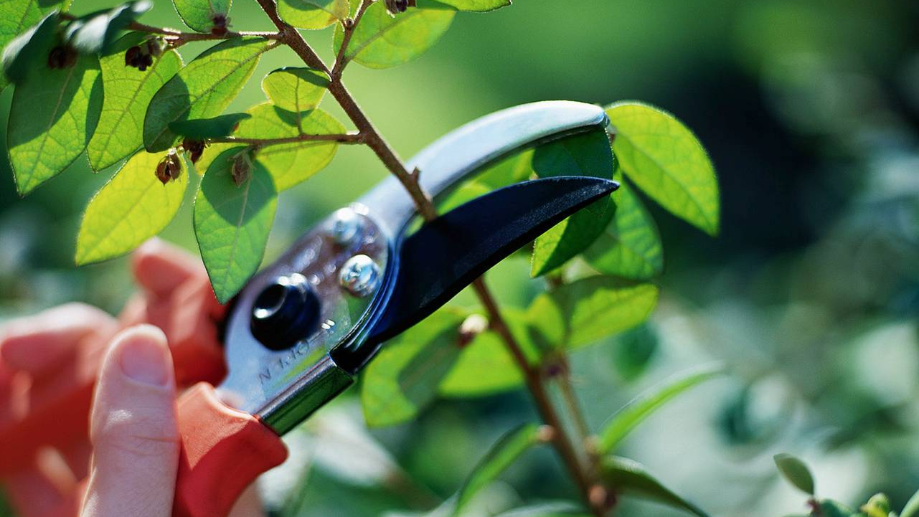
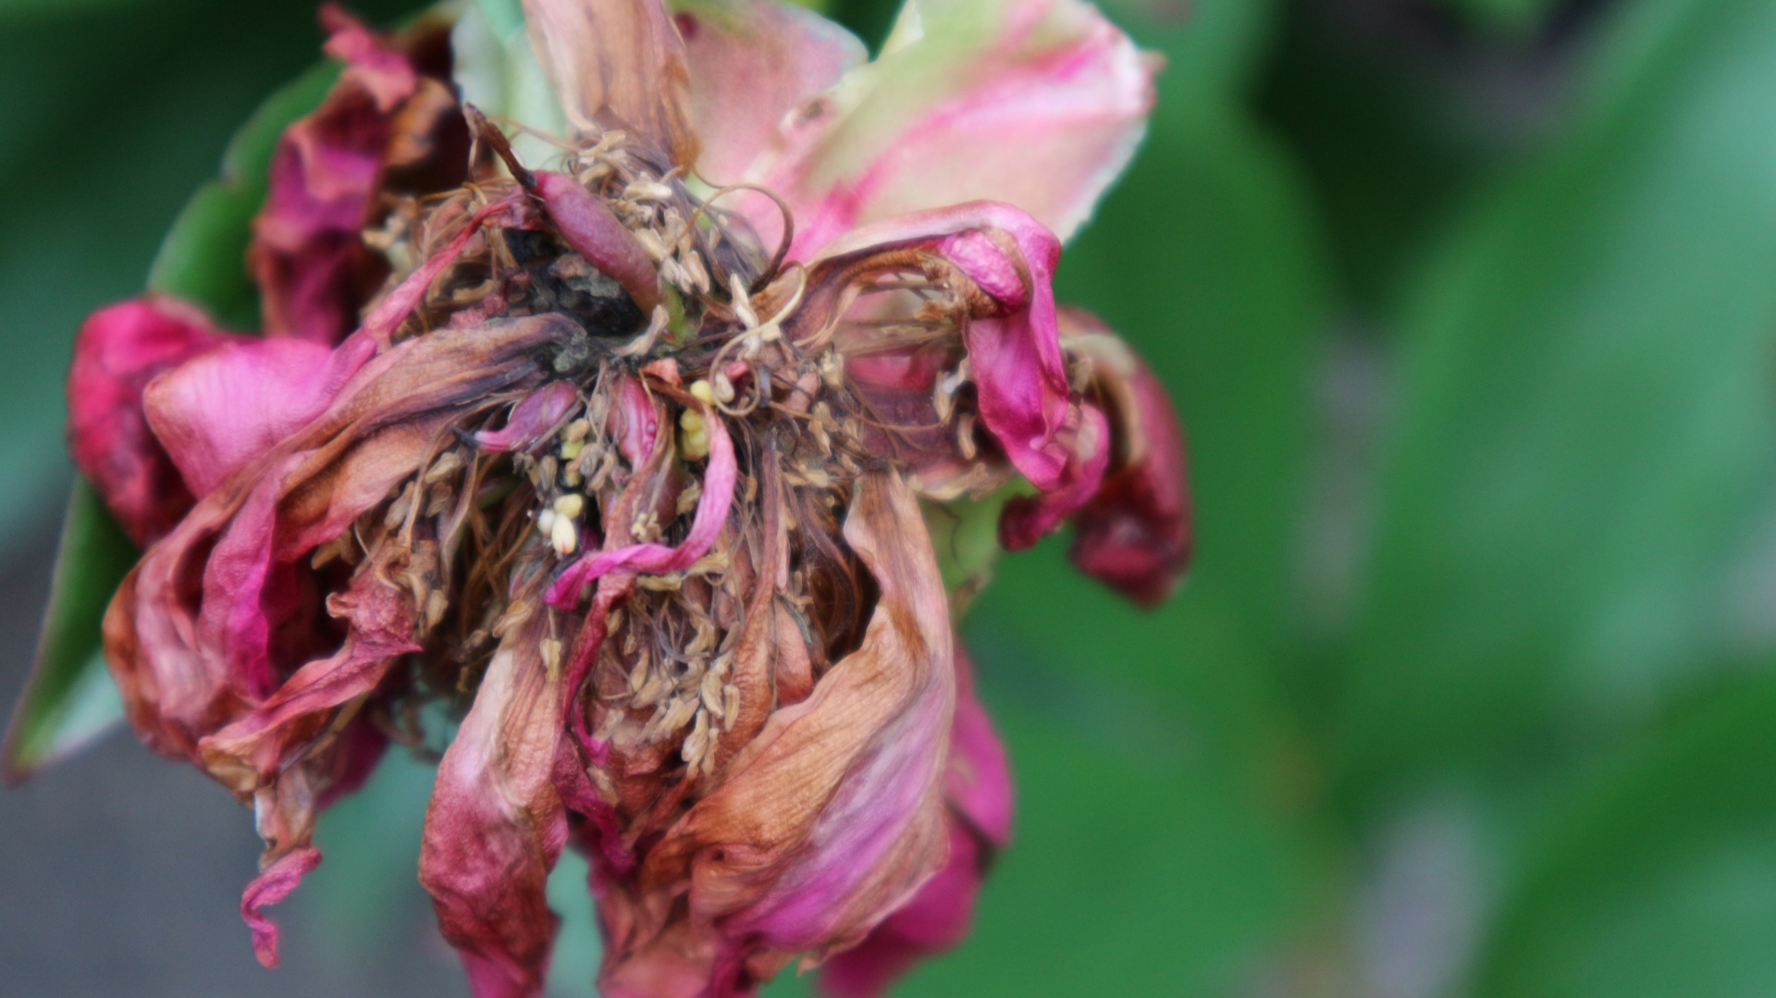
Theology of Endings
Growing
Withering
Pruning
Could it be that it is in the nature of the work of the Spirit to be the finisher as well as the initiator? (John Leach, Ending Well)
Notes:
We focus so much on starting new things- what does our scripture, tradition, experience, tell us about ENDING things?
Withering
eg., Isaiah 1:30, For you will be like an oak whose leaf fades away
Or as a garden that has no water. OR – Job 16:8, and in NT –Parable of the Sower - Matthew 13:6 or Mark 4:6 - And after the sun had risen, it was scorched; and because it had no root, it withered away.
Pruning- care and maintenance- cutting back both the bits which risk the life and strength and thriving of the rest of the plant –needs careful discernment and loving care not just hacking!
Eg., John 15:2 Every branch in Me that does not bear fruit, He takes away; and every branch that bears fruit, He prunes it so that it may bear more fruit. Abide in Me, and I in you. As the branch cannot bear fruit of itself unless it abides in the vine, so neither can you unless you abide in Me

Slide 6
Theology of endings
Seasons and life cycles
Ecclesiastes 3:1-22
For everything there is a season, and a time for every matter under heaven…
Notes:
Seasons- times for stopping, times for moving on (the opposite of static). A reminder of this ending in the bigger picture of God’s time
Ecclesiastes 3:1-22
For everything there is a season, and a time for every matter under heaven: a time to be born, and a time to die; a time to plant, and a time to pluck up what is planted; a time to kill, and a time to heal; a time to break down, and a time to build up; a time to weep, and a time to laugh; a time to mourn, and a time to dance; a time to cast away stones, and a time to gather stones together; a time to embrace, and a time to refrain from embracing; ...
Daniel 2:21
He changes times and seasons; he removes kings and sets up kings; he gives wisdom to the wise and knowledge to those who have understanding;
Genesis 8:22
While the earth remains, seedtime and harvest, cold and heat, summer and winter, day and night, shall not cease.”
Galatians 6:9
And let us not grow weary of doing good, for in due season we will reap, if we do not give up. (caution here-taken out of context, this verse is sometimes used to support an argument that ‘we must keeping doing everything !’)

Slide 7
Theology of endings
Journeying
Liminal Spaces
‘Liminality refers to (the) ambiguity or disorientation that occurs…when a person or group of people is in between something that has ended and something that is not yet ready to begin….The Christian story is, by design, an invitation into liminality’
How to Lead When you don’t know where you’re going- Susan Beaumont
NC
Notes:
‘Moving On’/ journeying – the whole story of the book of Acts and a Spirit who takes God’s people on a journey.
William Bridges (Transitions) – change is situational (eg. getting a new leader, or an old one leaving, adopting a new policy), transition is the psychological process (maybe also spiritual process?) people go through to come to terms with a change – transition depends on the ending of what was- saying goodbye to an old building, letting the old leader go, releasing identity attached to old roles.
Liminal spaces – Susan Beaumont’s book- ‘The natural human response is to resist liminality and to strive backwards to the old familiar identity, or forward to the unknown identity (think about the Israelites in Babylon, hanging up their harps and weeping, or the Israelites in the desert).

Slide 8
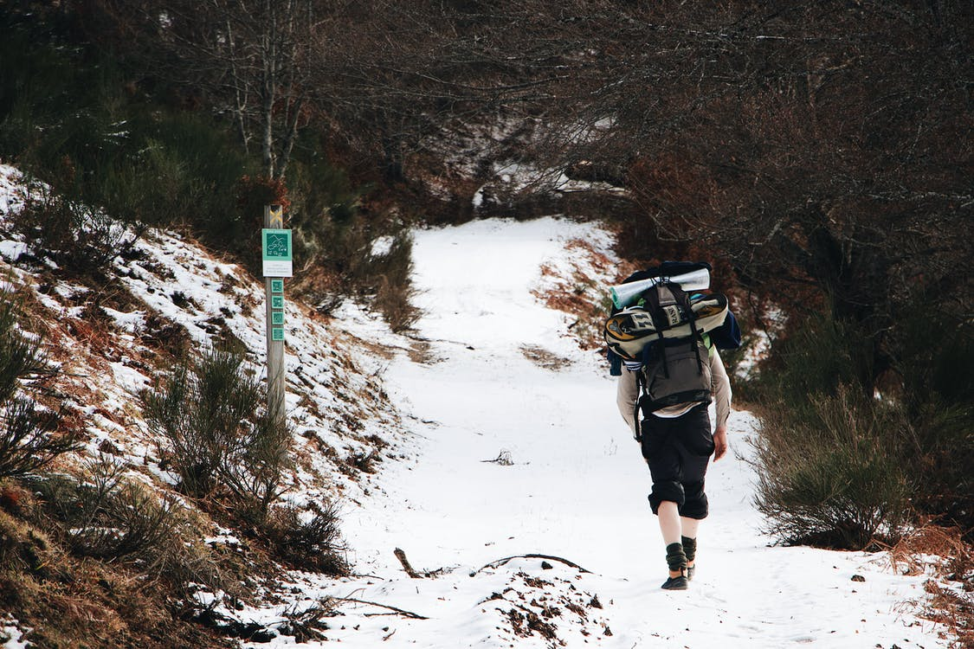
stepping stones and rucksacks
‘Our resistance stems from the fact that liminality always begins with an ending, an experience of loss. And humankind resists loss’ Susan Beaumont
Notes:
John Leach’s argument- that when we become too focused on (relatively) static metaphors for church life such as ‘family’ we lose sight of the concept of journey- and therefore the challenge to move from one stepping stone to the next, to leave behind the old one- is very difficult. Understanding our journey together as an ongoing movement- means moving on from one stone to another is less of a catastrophic crash and more of a life giving natural progression
Do you like his metaphor? Does it challenge you? What alternative would you offer?
My suggestions –that its like a rucksack, what we bring along with us- which we pack and repack along the way.

Slide 9
Leadership for in between times…
Notes:
So the kind of leadership we need –lay, ordained voluntary, are people who understand the nature of in between times, and know that our Christian journey involves moving, being active, has a sense of following spirit-
We need leaders who can themselves, and help others to, stop, and wait and see.
Susan Beaumont talks about the need for leaders to be a ’non anxious presence’ - who predict that ‘anxiety will rise and motivation will fall’ as something ends. Or who will try to plaster over the cracks, or add miracle grow! Old conflicts and tensions may resurface.
Adaptive leaders - able to regulate the pace of loss people experience and stop them’ bumping up against their liminal tolerance limit (from business management consultants- Heifetz, Linsky and Grashow) –
Collaborative leaders- working alongside colleagues and key volunteers- in Methodist churches, we can also draw on circuit, district support. We eed this for self and one another – people can often reject a good, effective liminal leader because they are making them feel comfortable- guiding them through grief and loss is tough work. Prefer someone who makes it all seem ok.
And ‘an effective leader will teach people about the importance and value of the liminal season, why they are feeling the way they are feeling, and what they can do with their anxiety.’
Liminal places- the temptation to rush through and find our way out. So don’t give in- but keep people focused on the adaptive work- resist the temptation to avoid people facing grief, disappointment, to say ‘nothing has really changed’
BUT- we can’t make people do this, only invite them.
Be alert to the danger in liminality (Beaumont calls this ‘the trickster’ – charismatic leaders or congregation/community members who can’t live well in community but instead promote confusion, chaos, discord- this isn’t the same as hearing all views-discern whether their behaviours are community / others focused or self serving. Are they committed to the welfare of the project./ organisation? (we are called to be gentle AND wise!)
Resist the temptation to rush into the next thing- the next project, the latest ‘idea’ or resource- what if we waited, and evaluated, and prayed some more?
See liminal space as a thin space- an opportunity for the group/ congregation to deepen their practices of prayer and discernment.

Slide 10
Steps to Ending well
Asking the question ‘Does God still want this’?
Taking a clear decision
Pastoral support- (ongoing)
Celebration and lament
Reviewing
‘Authentic spiritual discernment calls for walking on holy ground’ (Beth Ann Gaede)
Notes:
1. Have the courage to ask the question – what if every change of circumstance prompted our churches/ projects to ask ‘has God still got a purpose for this?’ ‘to what ministry is God calling us?’ ‘what not close?’ rather than trying to keep going, recruit new volunteers, etc. The importance of listening and discerning- and taking /allowing time to do this. Beth Ann Gaede- ‘where there is resistance, allow more time, the spirit will break through’. Ask Why do we think we are doing this/ still doing this? What is the point of this? Answers may be unexpected – John Leach ‘s example ‘because we are ‘supposed’ to be doing this sort of thing’ – which lead to further discussion. This is a collaborative process. If people aren’t committed to this – then there’s little point in attempting further spiritual discernment
Story/story telling as a useful tool- reflecting on past and then present story in order to discern future.
Weighing the emerging decision- and then resting with it- for a short time (Ignatian practices- consolation or desolation?)
2. Taking a clear, courageous decision- following the above, take the decision and abide by it – may be painful but is more helpful (think of the sticking plaster analogy). Choosing to discontinue gives control over how things end- with dignity, planning, support – but many drag on – which engenders false hope. Better to face facts, and deal with the grief.
3. Be prepared for grief, denial, and the ‘last minute rescue plan’ – ‘if we tried this or that’- how much of this is realistic, and spirit led?
Especially likely if the decision to lose hasn’t been well communicated - leads to further conflict and upset
Pastoral support may need to be offered to those impacted by the ‘ripples’ pf an ending be prepared for those on the ‘fringe’ of the project, and the impact on others beyond those immediately affected
Grief cycle - denial, shock, anger, depression Recognising the significance of loss- what does this project/ community/ event mean to people (how does it interweave with other parts of their lives?)
Common themes and questions asked- ‘why did this have to happen?’ ‘Why us? Couldn’t more have been done/ something else tried? What do we do now? What could we have done differently?. People may feel angry – especially if it hasn’t been appropriate for them to be part of the decision making body. Trust/ clear consistent communication helps.
4. Marking the moment- Leach equates this to ‘holding a funeral’ – allow for expressions of grief as well as celebrations of what has been achieved – and opportunity to look ahead/new hope. Beth Ann Gaede suggests meeting in he church that is closing and then moving to new place of worship for a ‘welcome’ meal- could similar be done following closure of, for example, luncheon club? A meeting in the hall, or near kitchen , to give thanks, share stories, and then move to meet in a new space, eg., coffee shop?
5. Finally- this is about those responsible for the decision making. An evaluation/ review/ learning space- once the immediate grief is over. Looking at the strengths and weaknesses of what ended, any mistakes made, ways things might have been done differently. About learning and mutual support rather than shame/ guilt.

Slide 11
‘God is rewilding the Church. The wild Messiah cannot be tamed. That inexpressible power at the heart of the Church may be hindered by invasive species, but cannot be quenched.
We too are summoned to be rewilded...to cooperate with the great regeneration of creation and invited to be part of what is emerging. We are beckoned along that trajectory of hope, inspired and energized by the new-every-morning love of God.
Hear the call to participate in the ultimate adventure. Jesus says, ‘Follow me.’
Steve Aisthorpe, Rewilding the Church
Notes:
Rewilding the church -
What should we do next – where and with whom should we take this conversation?

